Slide 1

By Bradley Rawson and Andrew Mellen

Slide 2

What Did We Do?
Multithreaded, Multiplayer Networked Tanks Game
Created a Custom Collision Engine/Algorithm
Created most image assets for the game

Slide 3
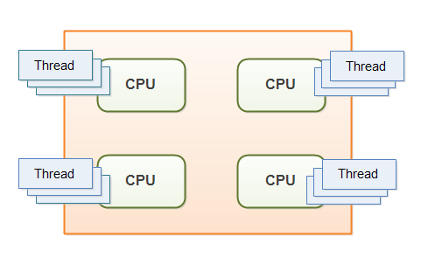
Quick Lesson About Multithreading
Multithreading is using multiple “threads” on your processor
Each thread in Java essentially makes a process for the CPU to run, independent of every other thread
Altering Memory (Volatile and Synchronized)

Slide 4
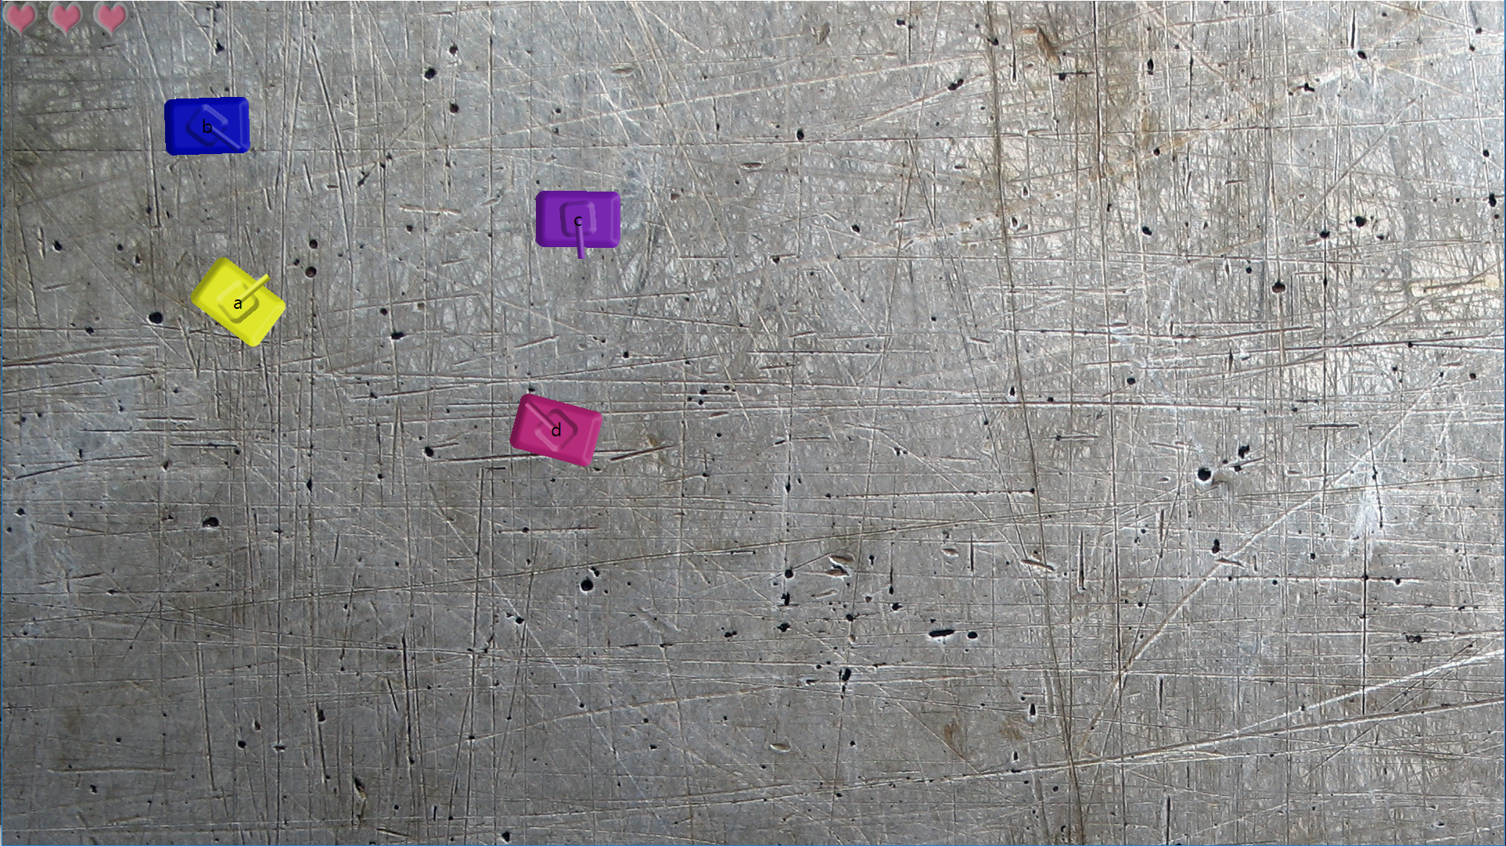
DEMO

